Slide 1
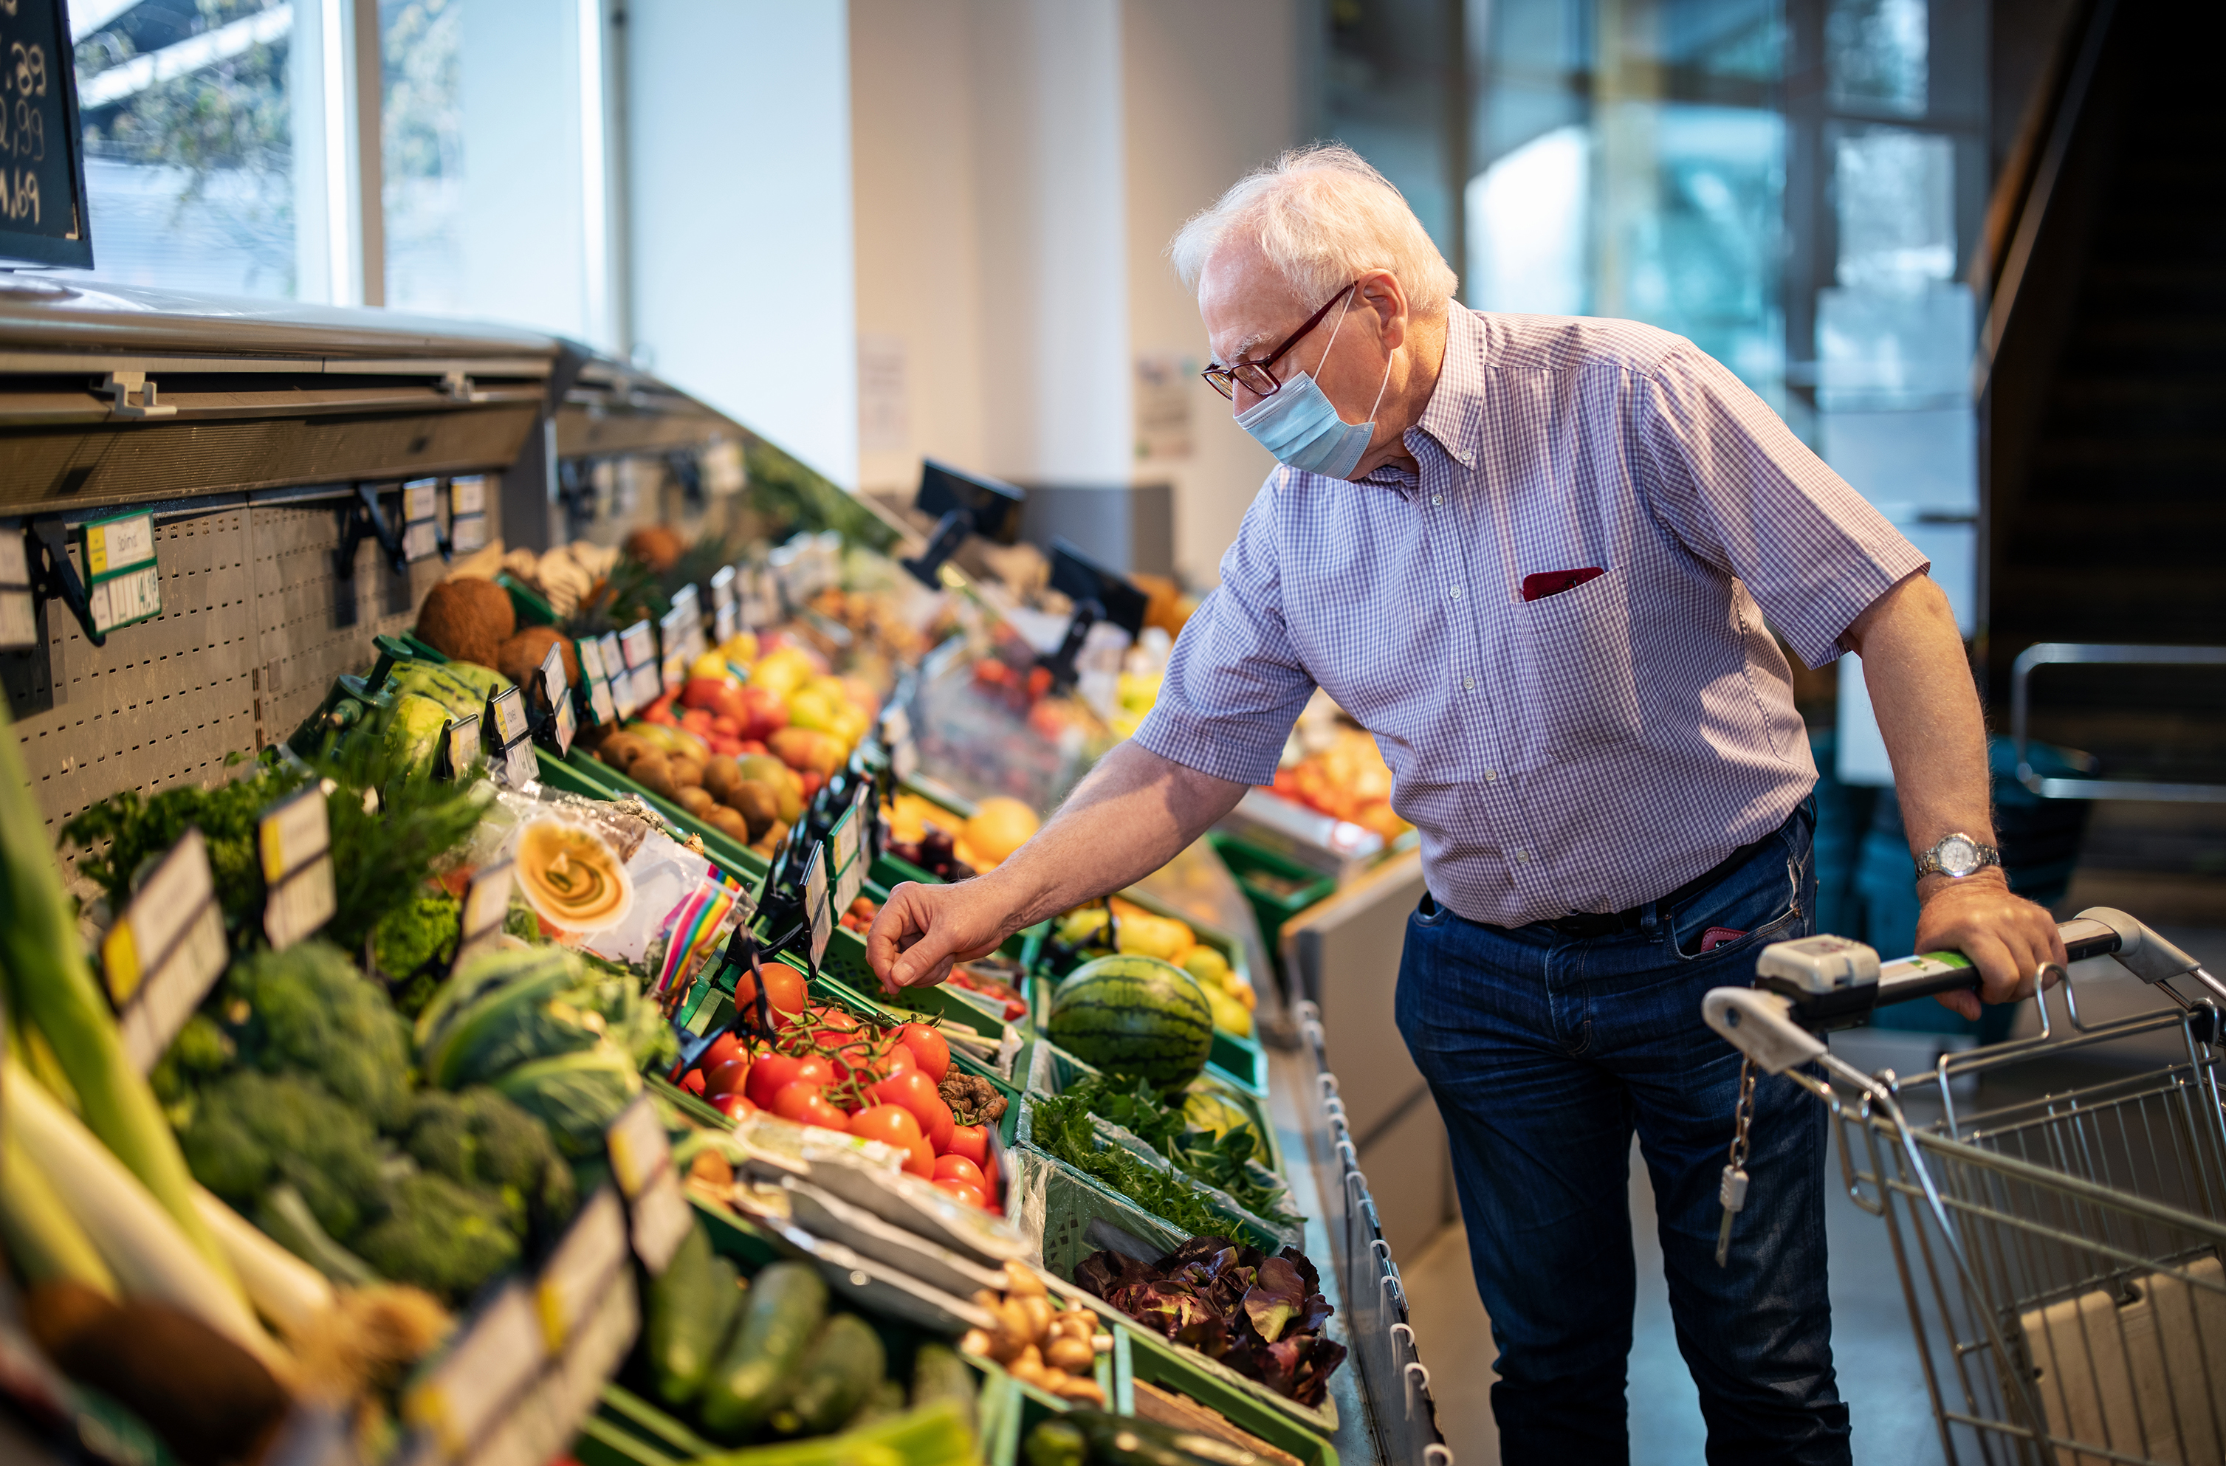

Innovating. Shopping. Experience.
Team Green - Edita, Femke, Jop & Luke

Slide 2


Contents
Starting situation
Design Thinking Venn diagram
Core concept
Redefining target audience
Norman’s 3 Levels of Design
Problem statement
Prototype
What’s next?

Slide 3
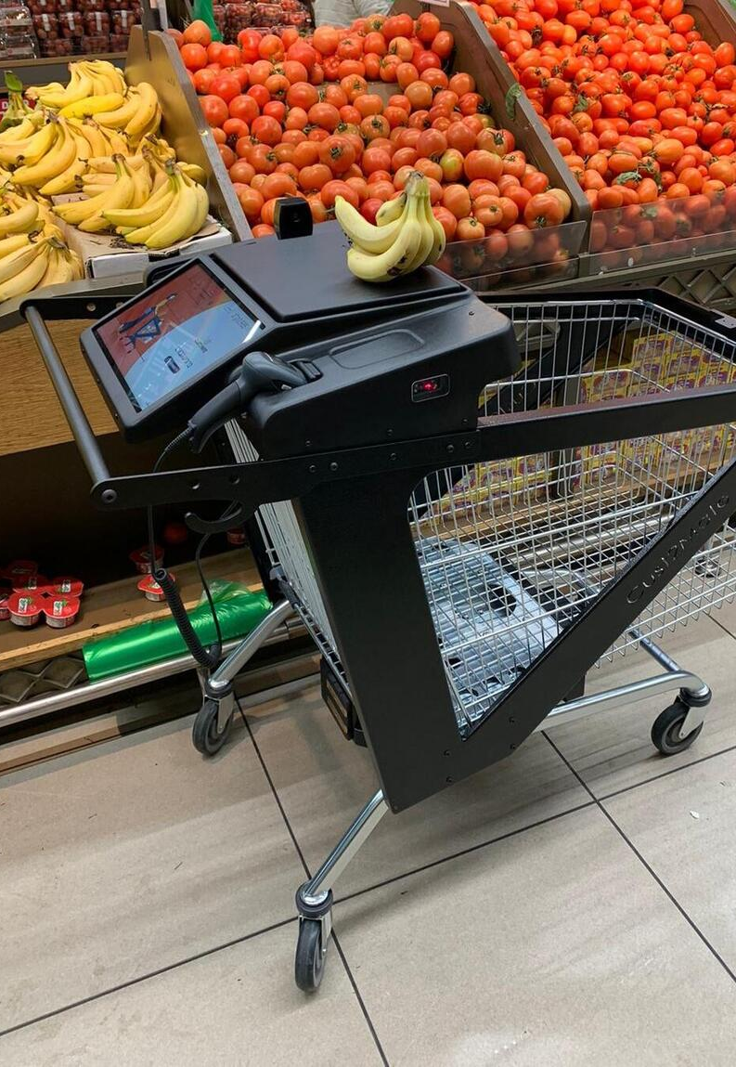
Starting situation
Karel the Cart
Virtual assistant
Personalization
"Just walk out"
Theft prevention
Navigation
Notes:
Last sprint we ended on 'Karel the Cart'
This concept consisted out of many ideas and features that were all over the place
We took those features and ideas and started ideating again

Slide 4

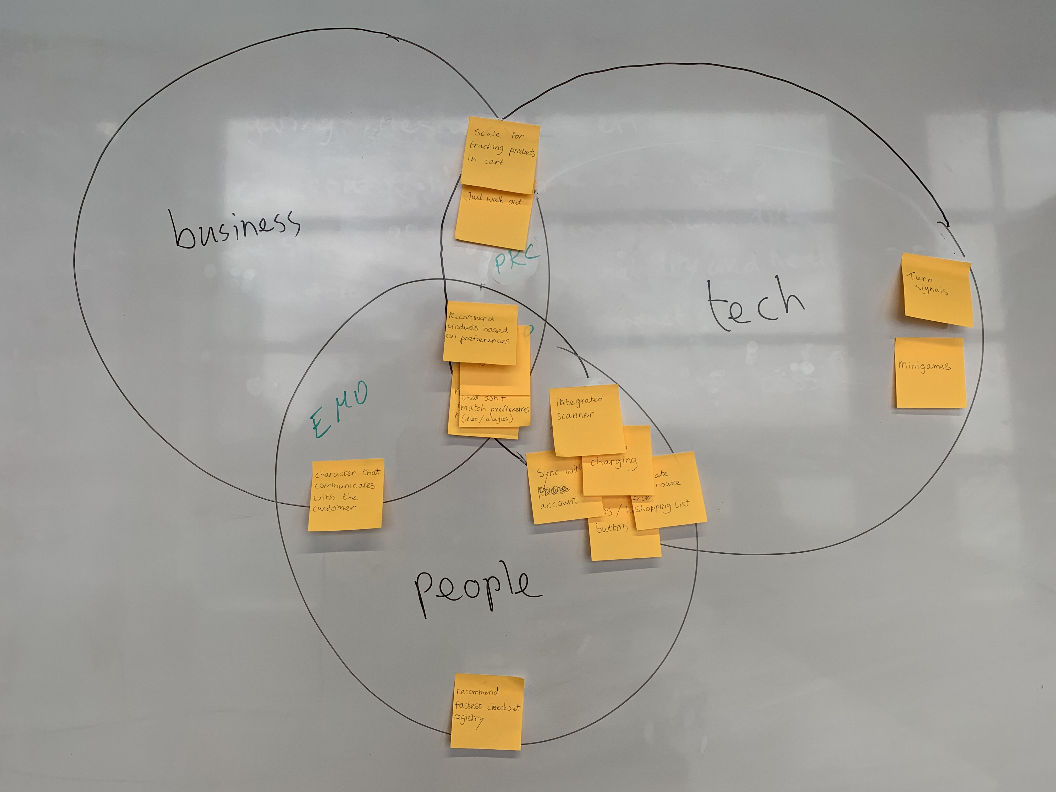
Design Thinking Venn diagram
Notes:
Filtered features we came up with in the DT Venn Diagram to see which features cover which aspects.
Business, Technology, People
Emotional, Process, Functional
Experience
Wrote down all smartcart functions and categorized them based on if they are good for Jumbo, the customer and technically feasible.
[next slide]

Slide 5
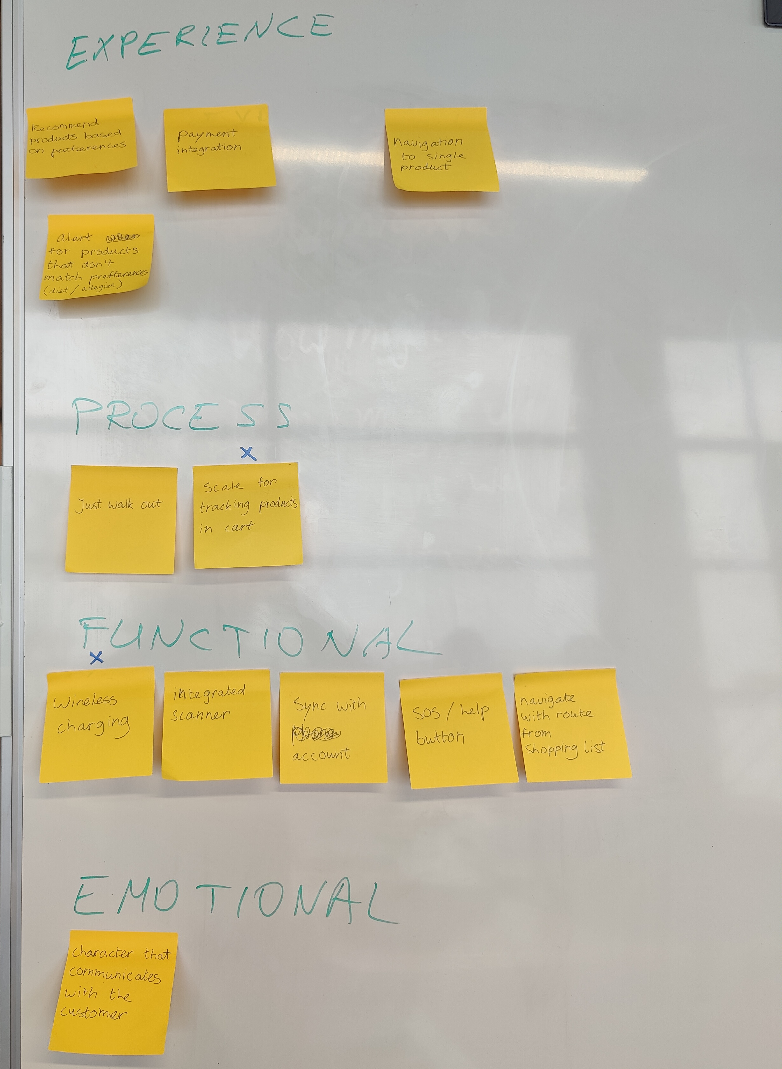
Experience:
Alert for products that don't match preferences
Recommend products based on preferences
Payment integration
Navigation
Notes:
Placed features we came up with in the DT Venn Diagram to see which features cover which aspects.
Business, Technology, People
Emotional, Process, Functional
Experience
[next slide]

Slide 6
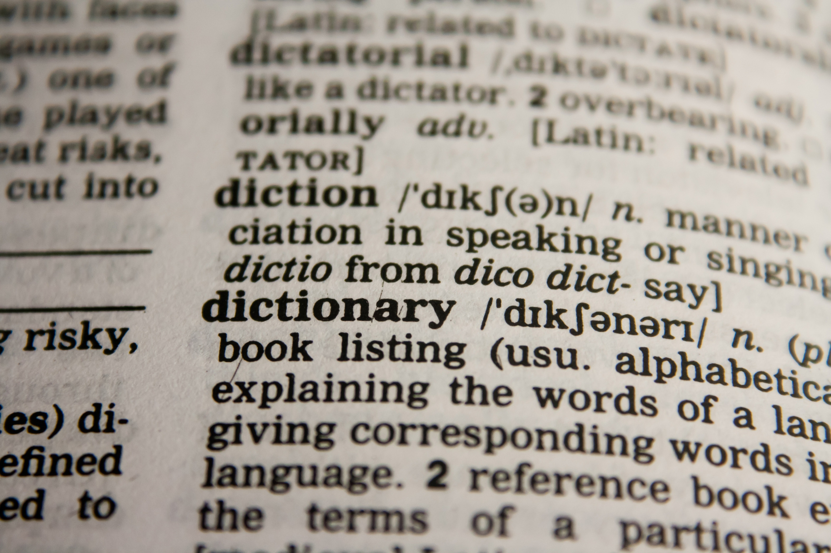
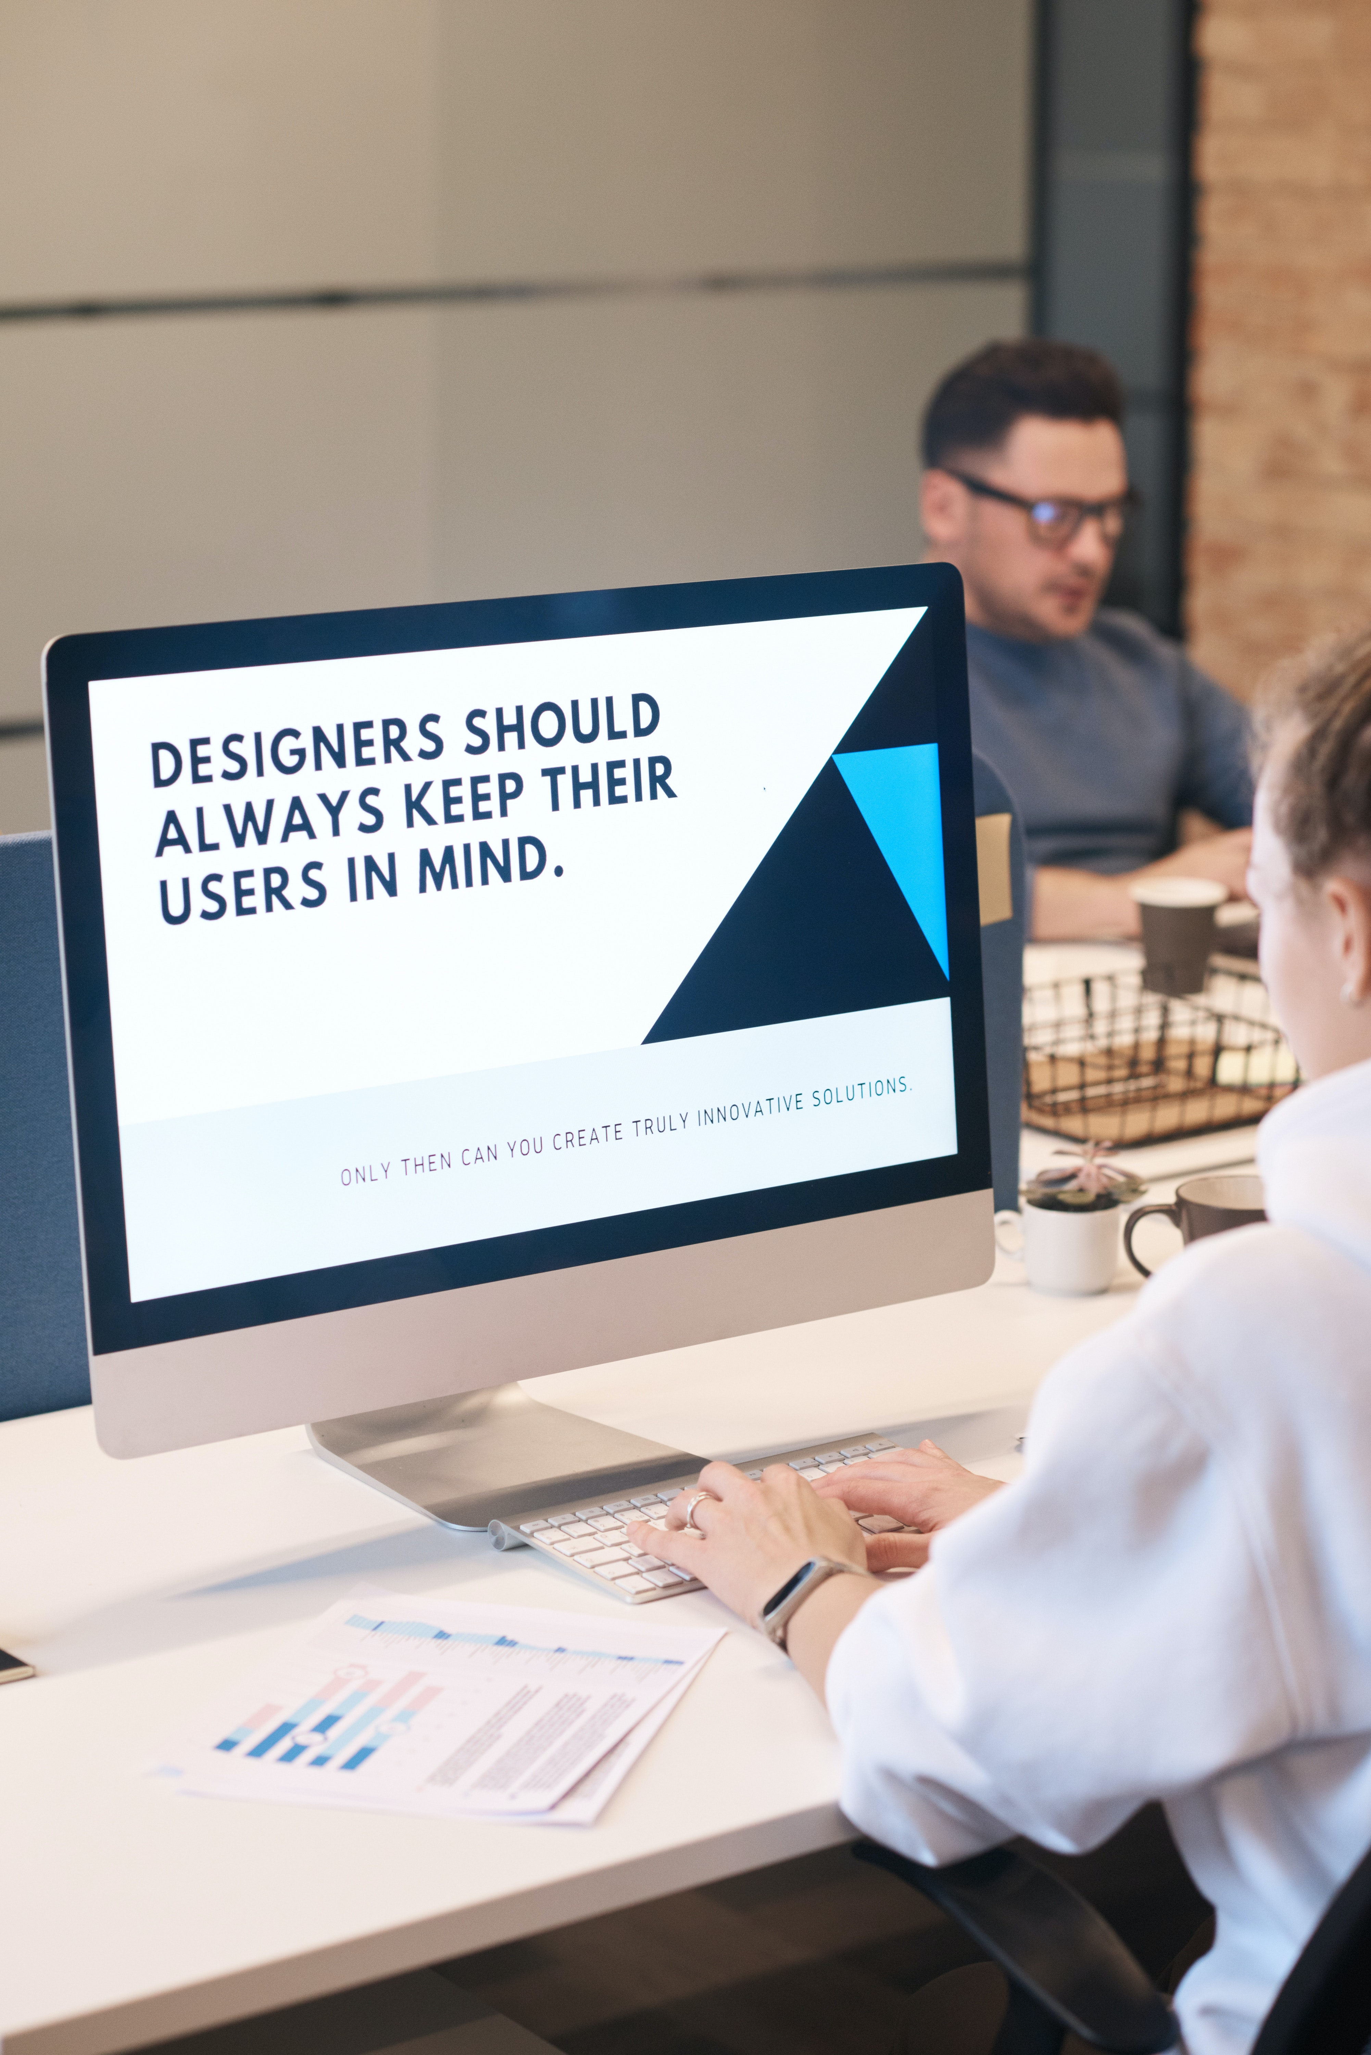
Core concept
Save diets, allergies, intolerances
Scanning & shopping cart
Help identify 'threatening' ingredients
Recommend alternatives
Fast checkout
Notes:
The core concept is: EXPAND EXISTING SCANNING APP FEATURES

Slide 7
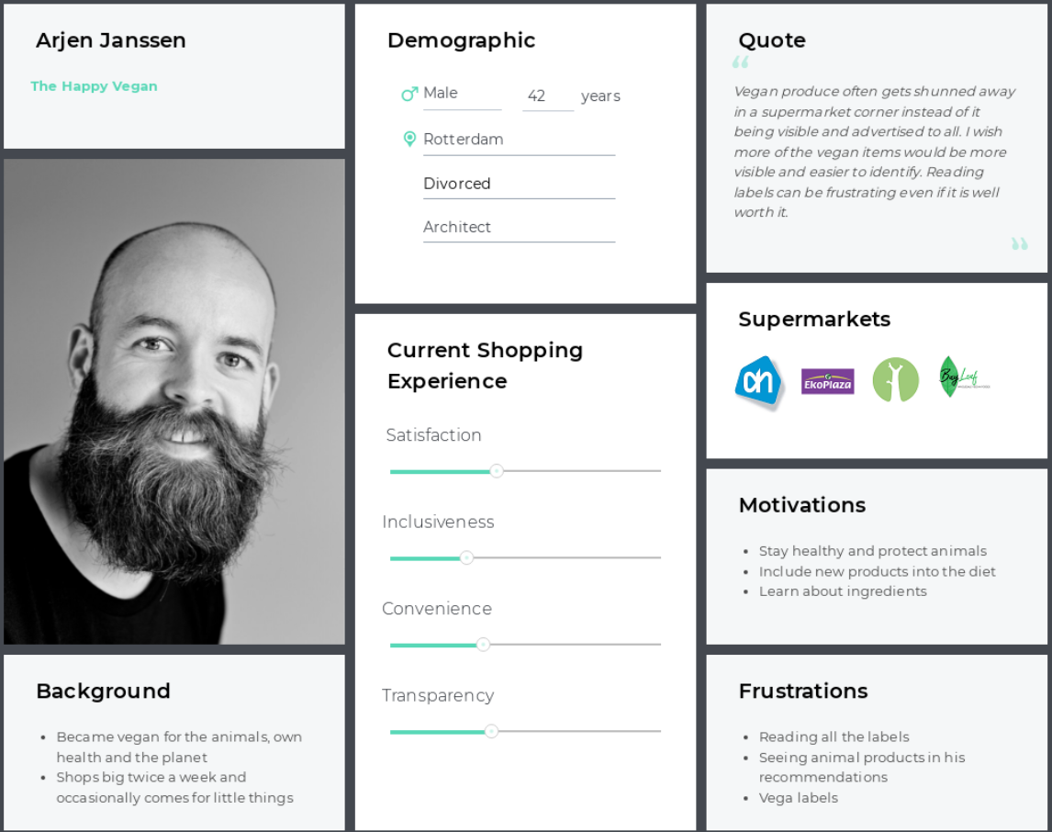
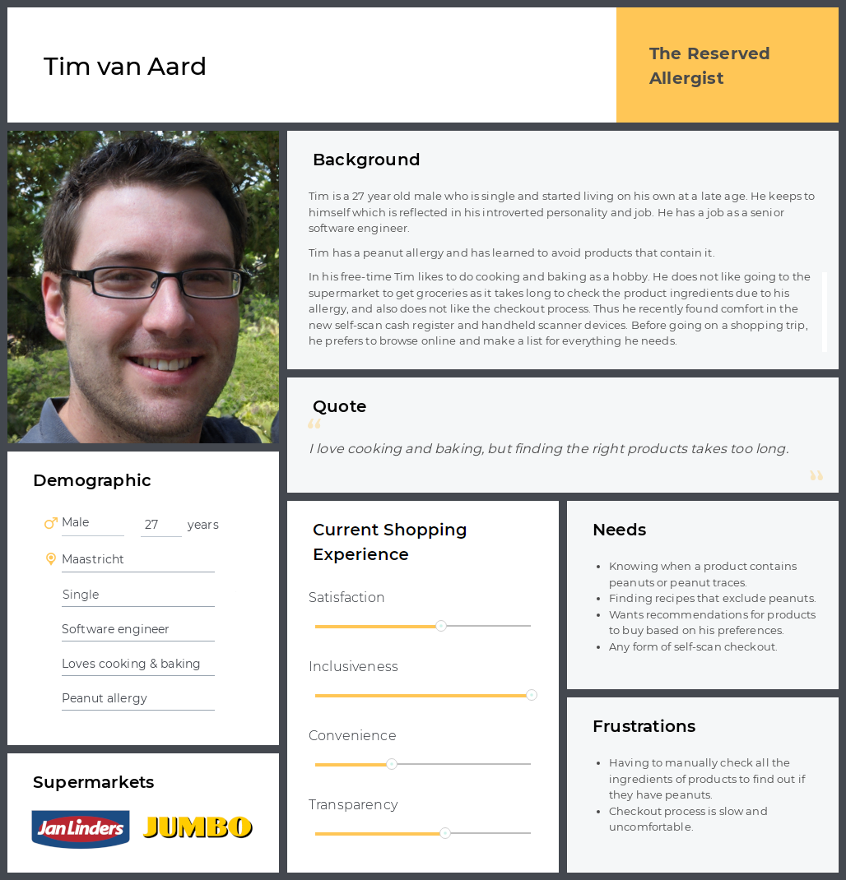
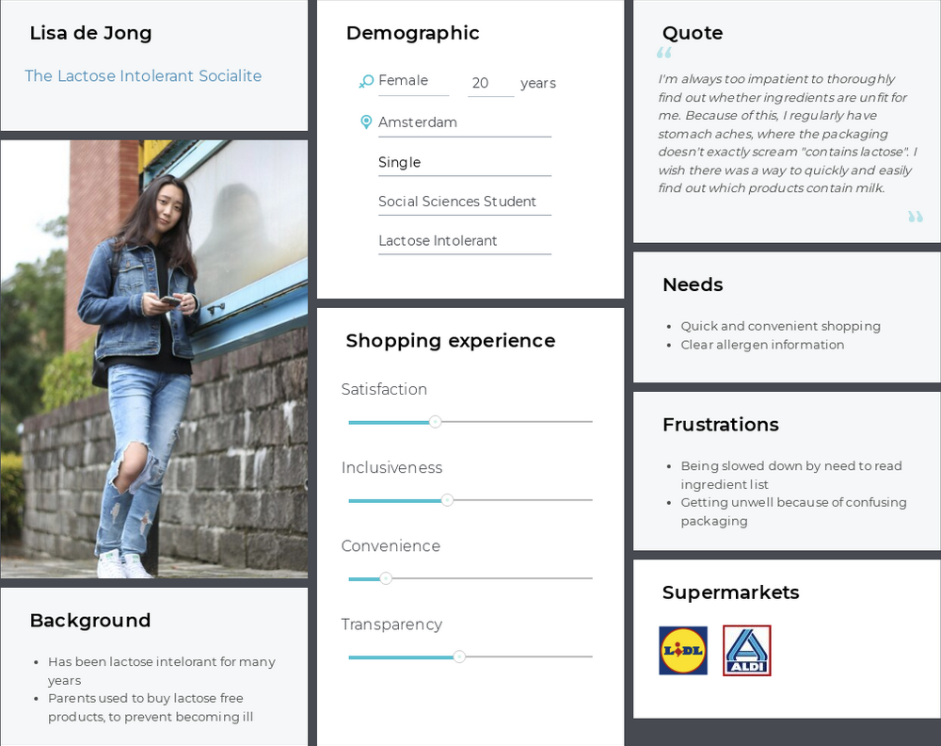
Redefining target audience
Notes:
- mention interviews

Slide 8
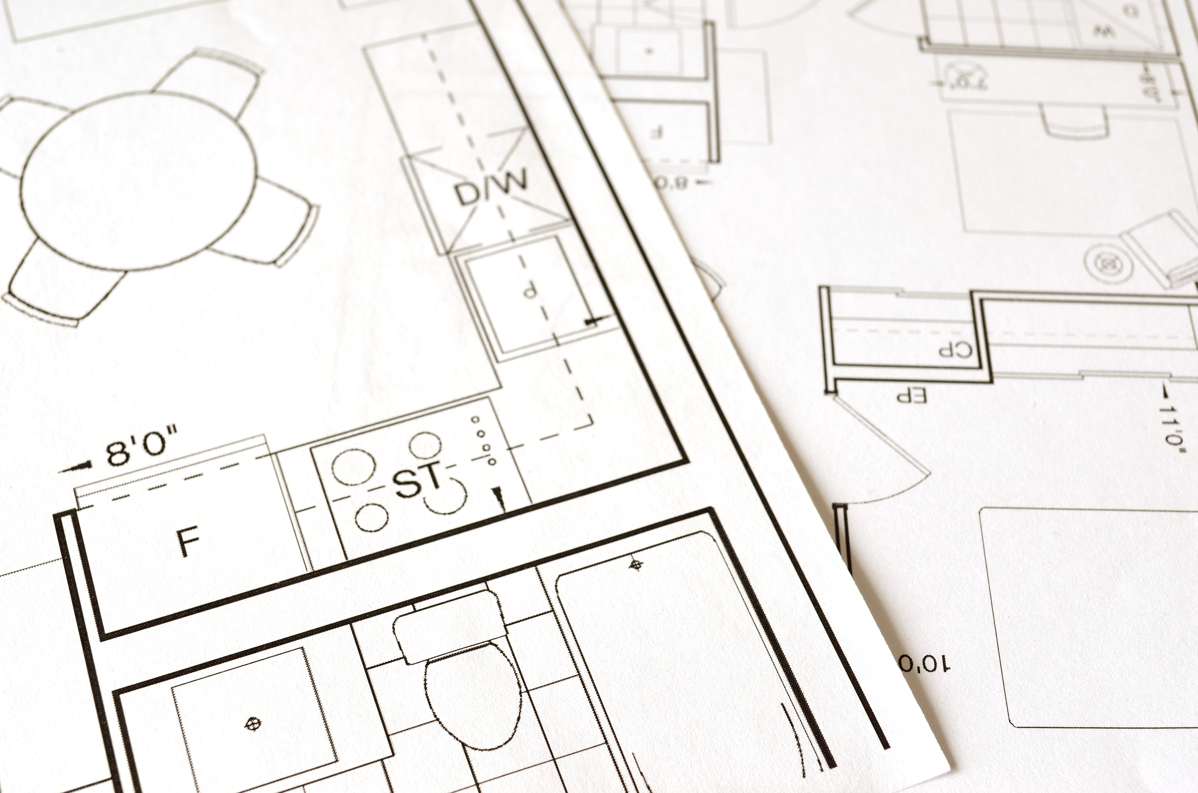
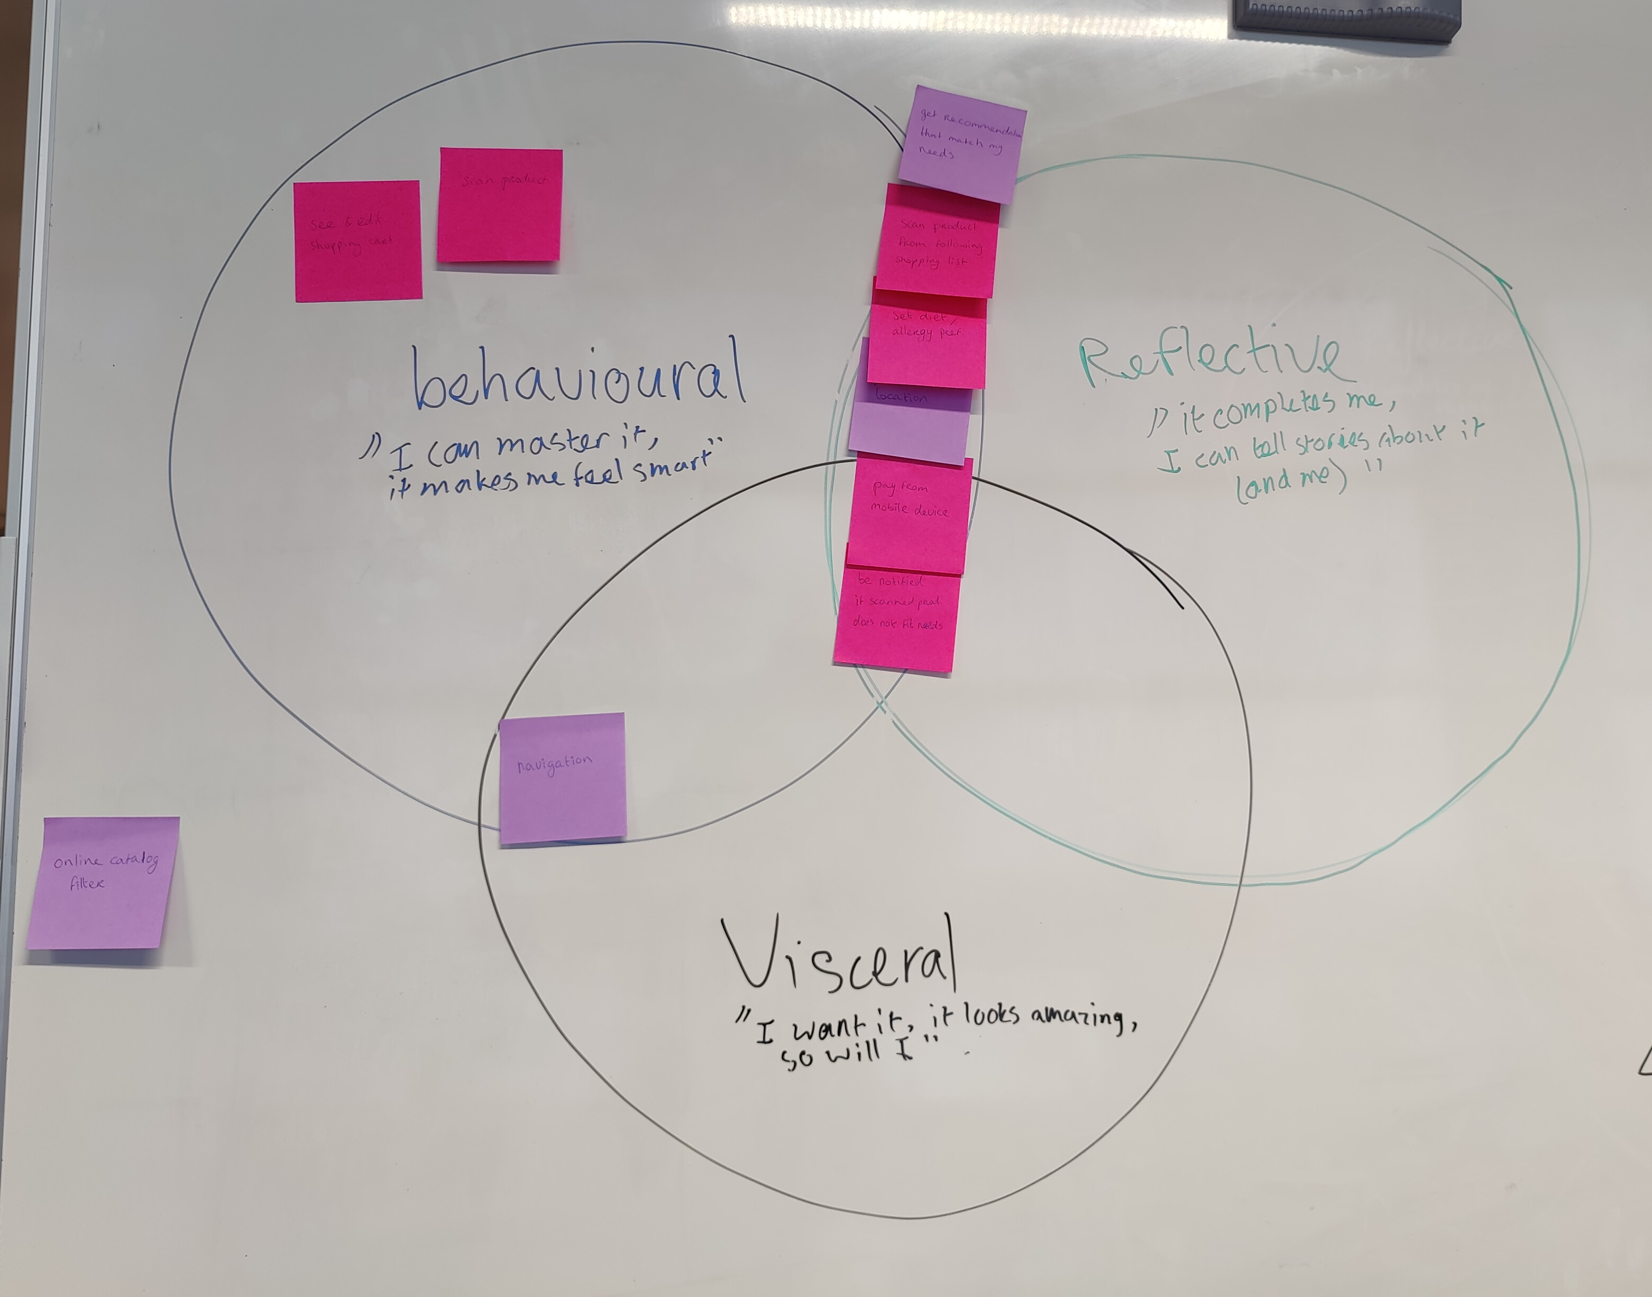
Norman’s 3 Levels of Design
Notes:
How each user story related to each persona.
Tim – Well known Peanut Allergy
Obviously since peanuts are very threatening to him, WARNINGS ABOUT WRONG INGREDIENTS are most important to him.
Is reserved and tech savvy (software engineer) so MOBILE PAYMENT related to him most.

Slide 9
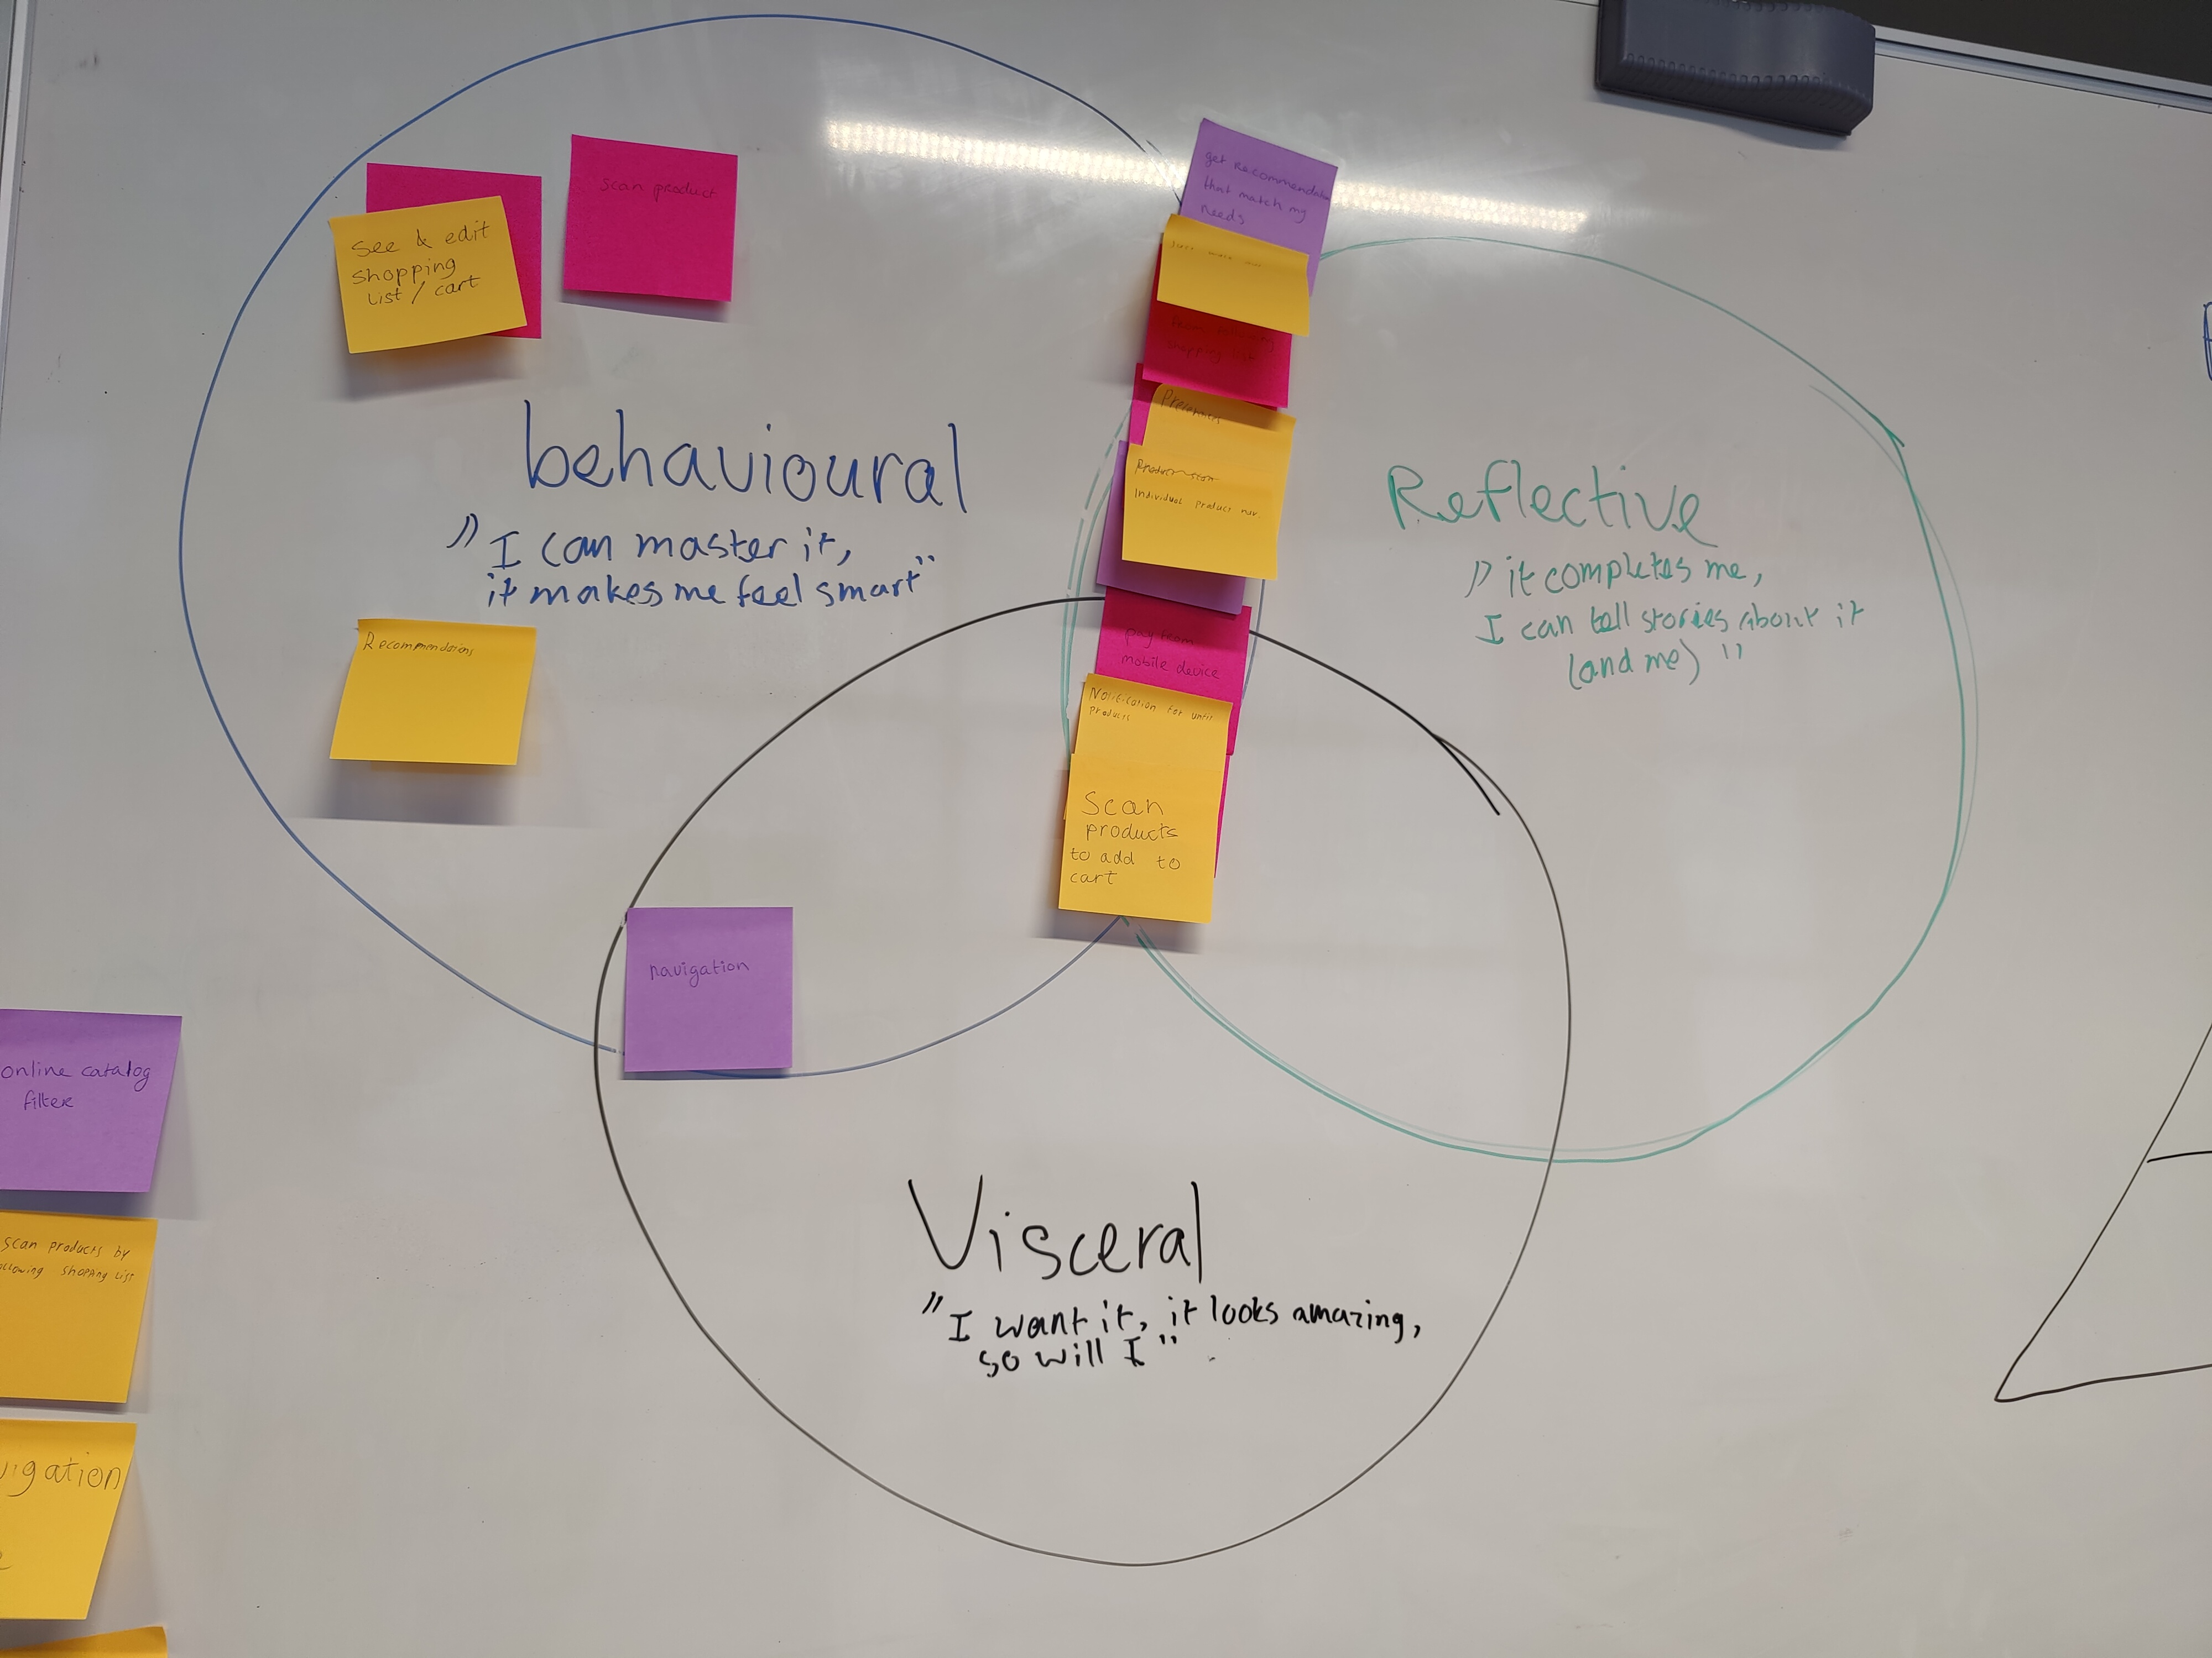
Notes:
Lactose intolerant student of social studies,
Extrovert, often feels unwell due to buying products containing lactose but is too impatient to read all labels
Most fitting features:
- Product scanning – is not very patient so this feature will help save time
- Product notification – very fitting to prevent getting unwell

Slide 10
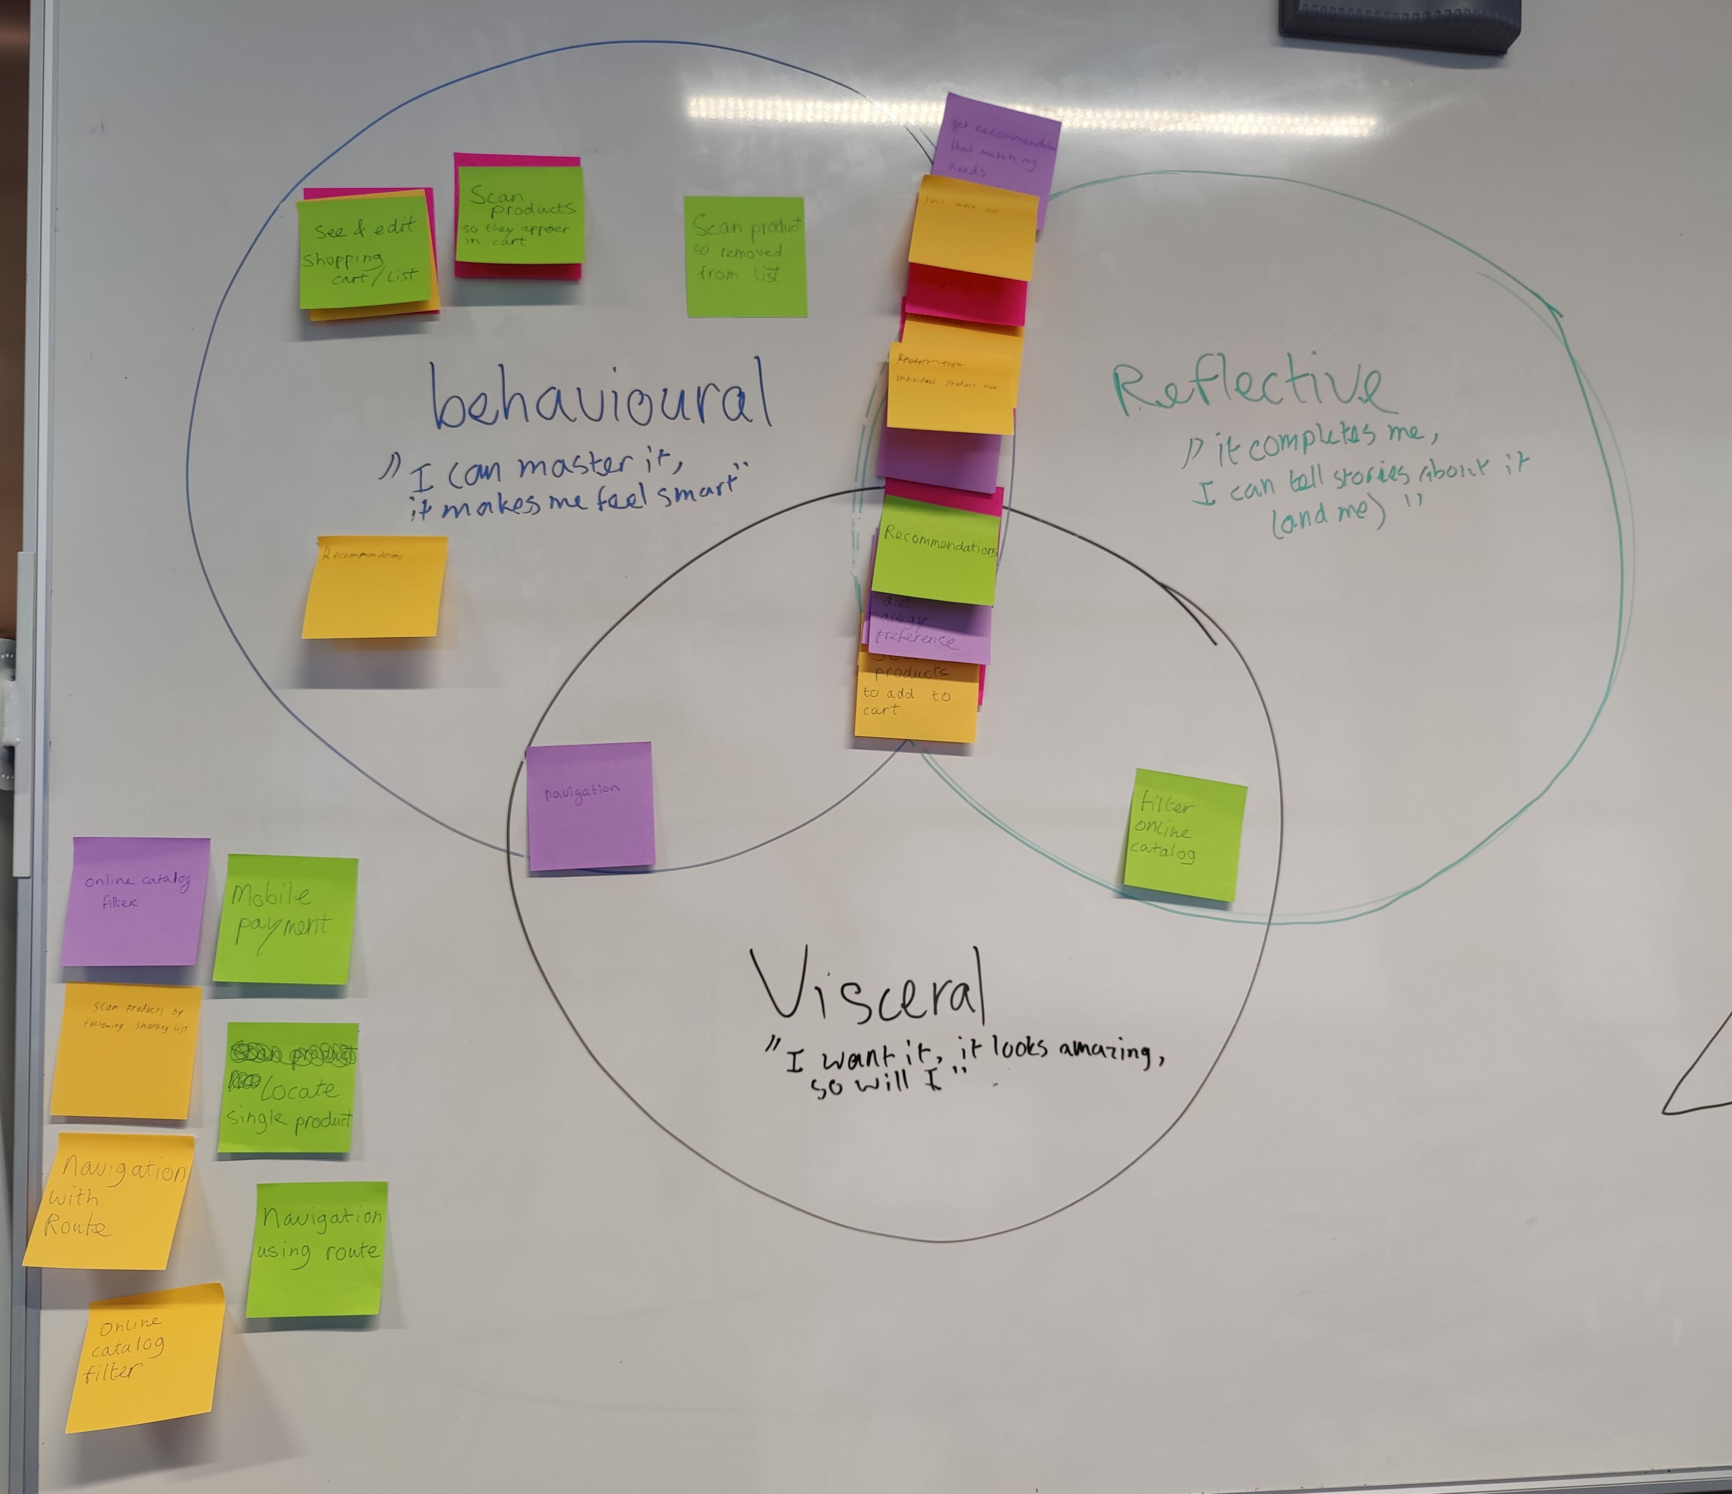
Notes:
Arjen – Vegan
Set diet preference
Recommendations
Likes to be and feel included as a vegan.

Slide 11
Problem statement
Marc Hassenzahl UX analysis
WHY WHAT HOW
“Shoppers with allergies, intolerances and diets need to quickly identify threatening ingredients in products because checking the ingredient list of each product in-store can be frustrating, time consuming and inconvenient.”

Slide 12
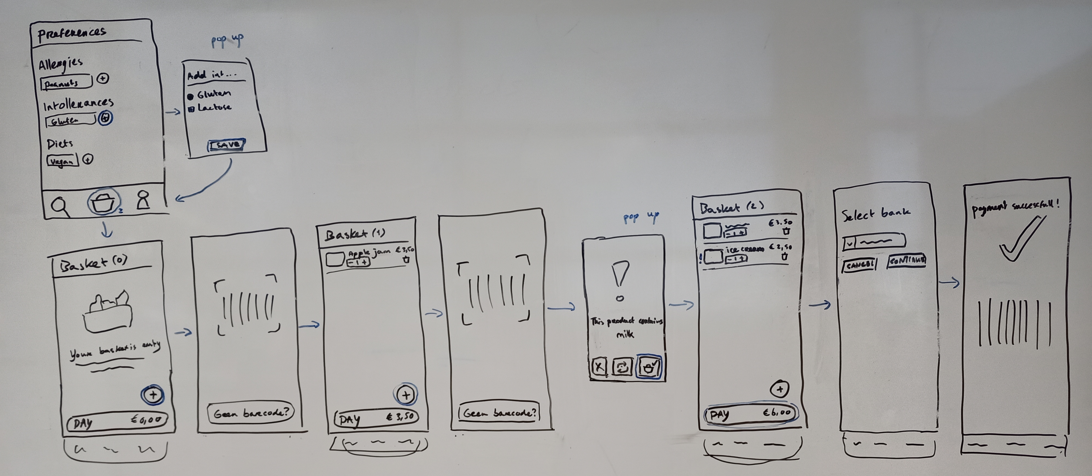
Prototype

Slide 13


What’s Next?
Digital prototype
Technical prototype
User testing
Notes:
Technical prototype: includes choosing framework and language

Slide 14

Feedback & Questions

